Slide 1

GENERATING SYNTHETIC FLIGHT TRACKS USING GENERATIVE ADVERSIAL NETWORKS (GAN’S)
DAEN 690
GEORGE MASON UNIVERSITY

Slide 2







Team – Sky Squad
Scrum Master
Neeraj Kumar Neela
Product Owner
Naga Pranavi Kandarpa
Developer
Sai Yeshwanth Reddy Chinakota
Instructor
Prof. F. Brett Berlin
Developer
Pravallika Avula
Developer
Junaid Mohammed
Developer
Lalithanjali Yarrapatruni

Slide 3

Partner – Lance Sherry
Stochastic simulation of complex systems - Air Transport and Autonomous Systems
Flight Test Engineer, Architect, Strategic Planner
Patents, Over 100 publications, Industry Awards
Associate Professor
Director at Center for Air Transportation Systems Research
Department of Systems Engineering and Operations Research

Slide 4

Problem Statement
CRM tracks air-to-air collision risks.
Traditional models may underestimate risks.
Limits in generating diverse flight simulations.
Project uses GANs for synthetic flight tracks.
GANs improve data sets for risk modeling.

Slide 5
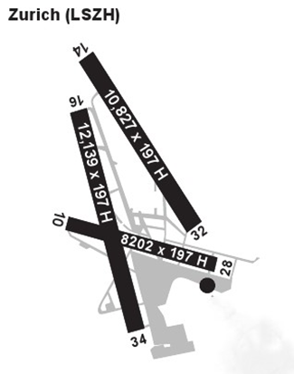
Data
Data from Open Sky
71,400 rows and 20 columns
Zurich airport Runway 34 data
No duplicate columns
Each flight has 200 rows data.

Slide 6
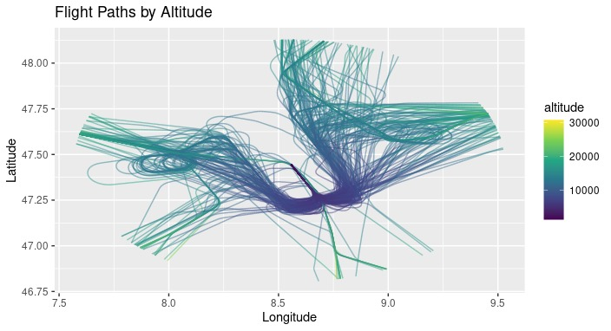
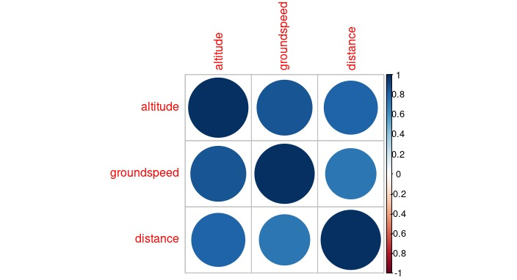
Dataset Analysis
Multi-parameter Analysis: This scatter plot matrix visualizes relationships between flight parameters (altitude, speed, time). By studying these correlations, we can understand how changes in one variable (e.g., altitude) may impact others (e.g., speed), crucial for flight modeling and air traffic management predictions.
Flight Path Visualization: This map displays the actual flight path of an aircraft, tracing its route from origin to destination. It provides valuable geographic context by showing the trajectory over terrain, enabling analysis of factors like: Route Efficiency: Identifying potentially inefficient paths for optimization.
Airspace Usage: Understanding how airspace is utilized by different flight patterns.
Flight Plan Compliance: Verifying if the flown path adheres to the planned route.

Slide 7
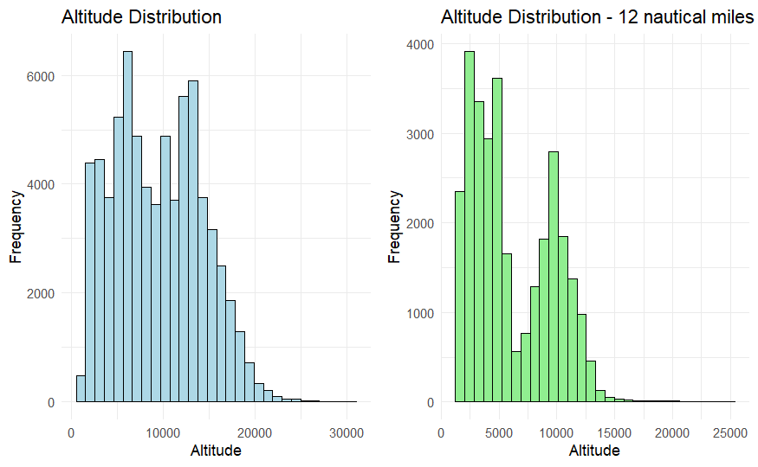
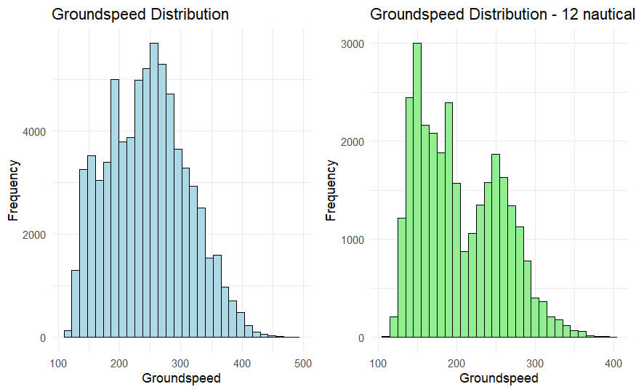
Exploratory Data Analysis
Vertical Flight Profile: This histogram depicts the distribution of flight altitudes across the dataset. It reveals common cruising altitudes and variations due to flight phases (takeoff, landing)
Altitude Distribution: Peak flight activity occurs around 6,000 feet altitude. Within a 12 nautical mile range, the peak altitude is around 4,000 feet.

Slide 8
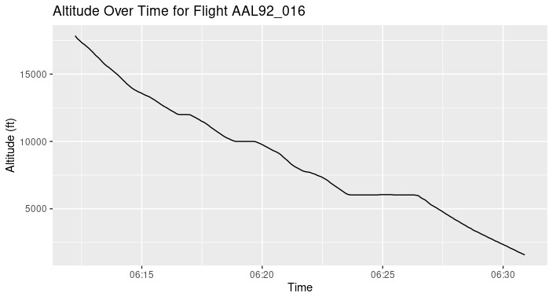
Exploratory Data Analysis
Similar to altitude, groundspeed distribution reveals typical flight speeds (250-300 knots) and helps identify potential outliers or operational patterns based on speed variations (e.g., peaks at 300 knots within 12 nautical miles)

Slide 9
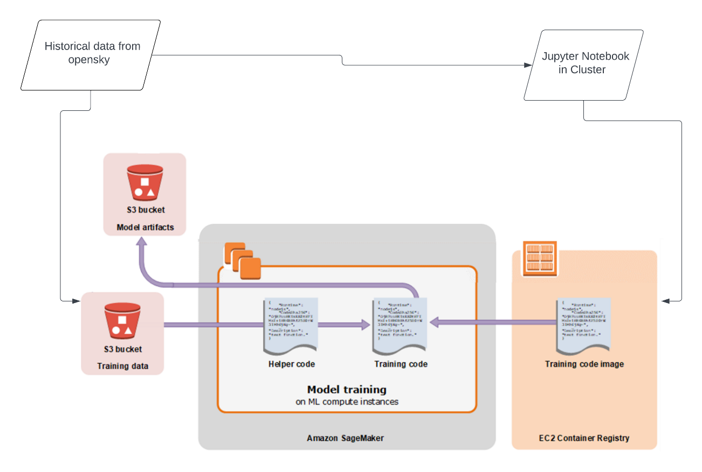
Architecture
Stores data on Amazon S3 for scalable and secure access.
Utilizes cloud-based computational clusters with flexible VM options.
Employs Jupyter Notebooks for interactive GAN model development.
Constructs GANs in preferred deep learning frameworks like TensorFlow or PyTorch.
Generates realistic flight tracks for simulation and optimization applications.
Incorporates data preprocessing, secure storage, model training, and track generation in workflow.
Adapts architecture to different cloud providers, specifically using AWS for this project.

Slide 10
Algorithm Analysis
Preprocess data by flight ID for 200 points.
Use scaling algorithm to normalize features.
GAN uses noise vectors to create synthetic routes.
Train GAN in loops for quality enhancements.
AWS S3 and Hopper cluster facilitate GAN training.
GAN performance tweaked with network topology tests.

Slide 11
ML – Model Exploration and Selection
Utilizes GANs to mimic real-world time series data patterns.
Incorporates a generator for creating data and a discriminator for authenticity checks.
Employs unconditional generation to produce diverse time series data without specific inputs.
Uses conditional inputs to generate time series with desired characteristics.
Extends GANs for multi-modal data generation, capturing different data modes.
Enhances anomaly detection by generating synthetic data for model training.
Uses synthetic data for data augmentation in limited or imbalanced datasets.
Applies synthetic data for scenario forecasting in predictive models.
Trains GANs through adversarial processes to improve synthetic data realism.
Selects GANs for their ability to produce diverse, realistic data crucial for new technology representation and airspace management.

Slide 12
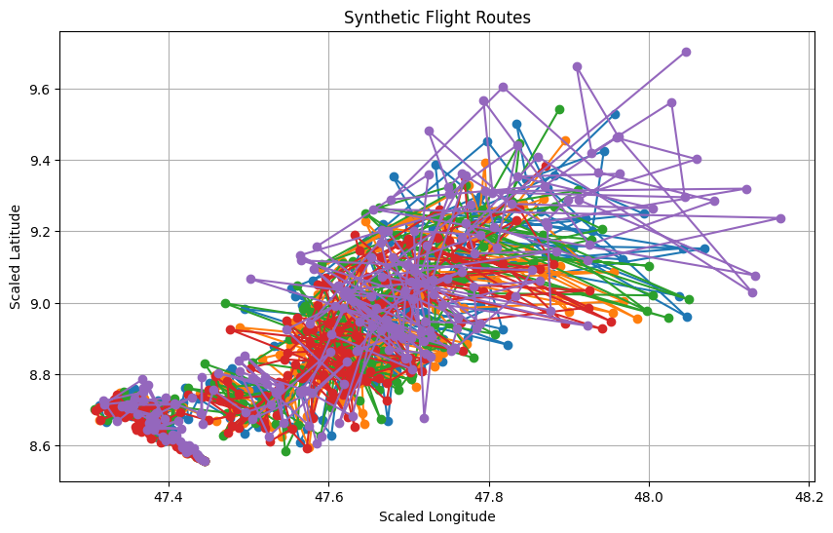
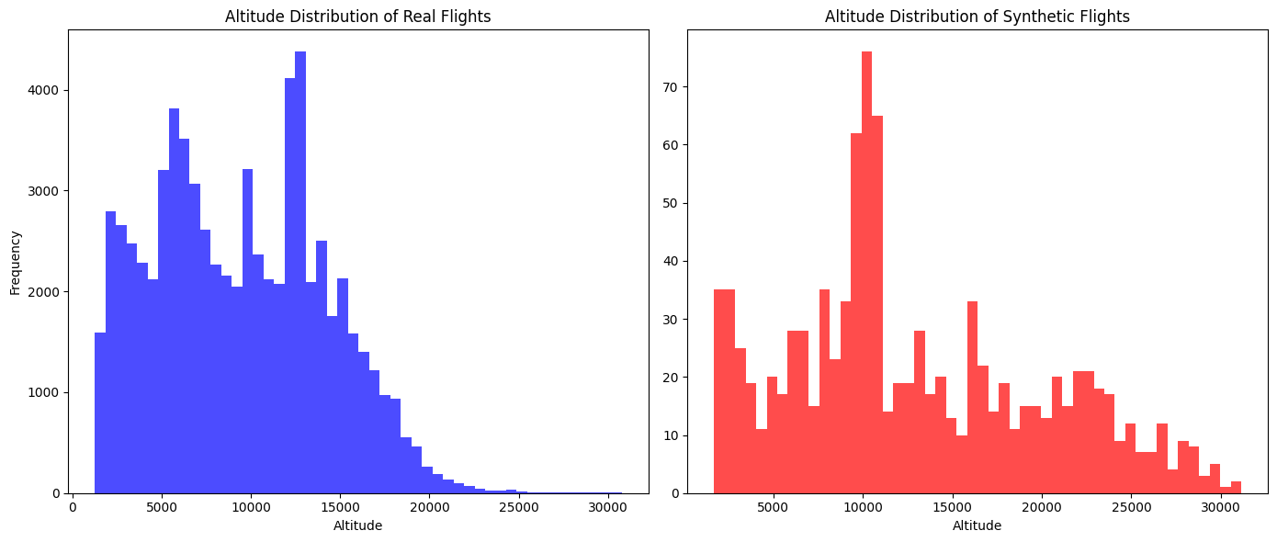
Visualizations – MinMax Scaling
Synthetic Flight Routes
X Axis: Scaled Longitude
Y Axis: Scaled Latitude
Altitude Distribution
X Axis: Altitude
Y Axis: Frequency

Slide 13
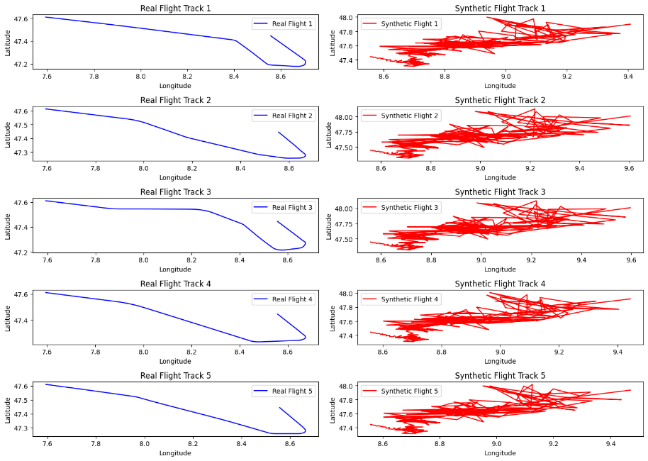
Visualizations – MinMax Scaling
Comparison
X Axis: Longitude
Y Axis: Latitude

Slide 14
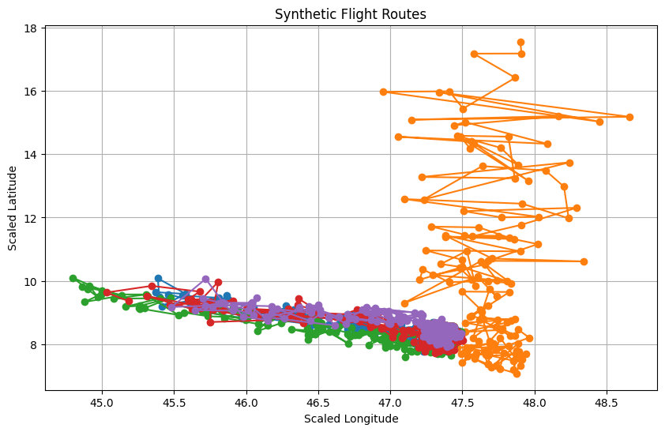
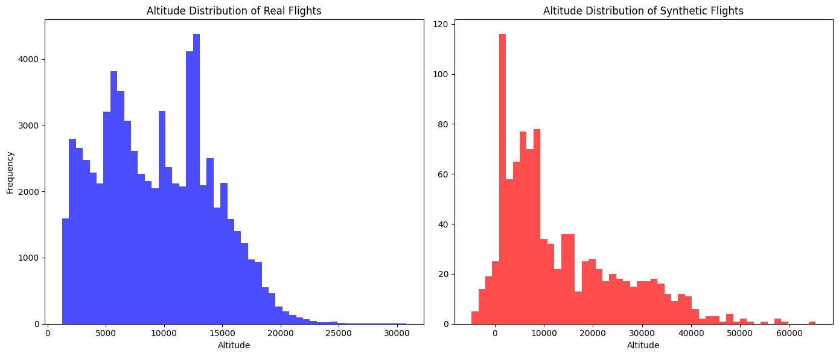
Visualizations – Standard Scaling
Synthetic Flight Routes
X Axis: Scaled Longitude
Y Axis: Scaled Latitude
Altitude Distribution
X Axis: Altitude
Y Axis: Frequency

Slide 15
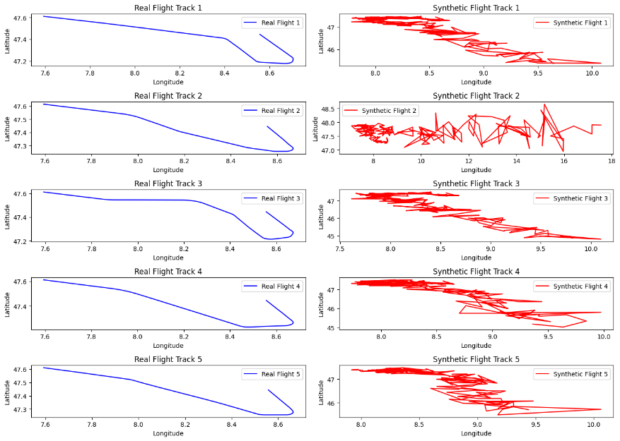
Visualizations – Standard Scaling
Comparison
X Axis: Longitude
Y Axis: Latitude

Slide 16
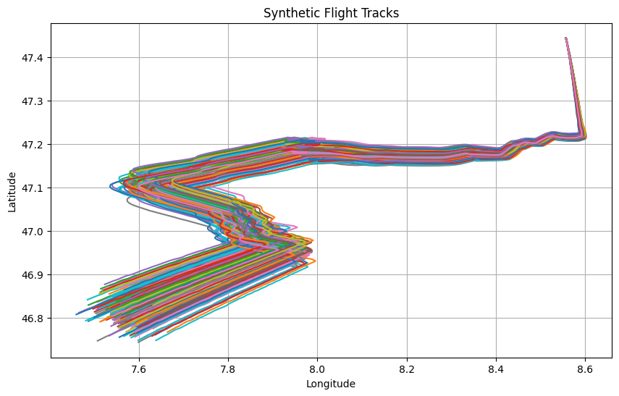
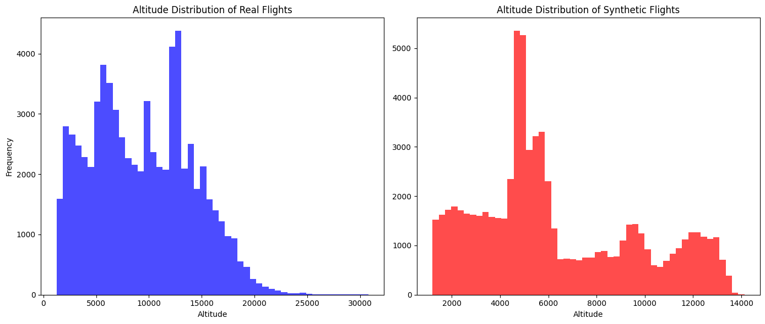
Visualizations – Wasserstein GAN
Synthetic Flight Routes
X Axis: Longitude
Y Axis: Latitude
Altitude Distribution
X Axis: Altitude
Y Axis: Frequency

Slide 17
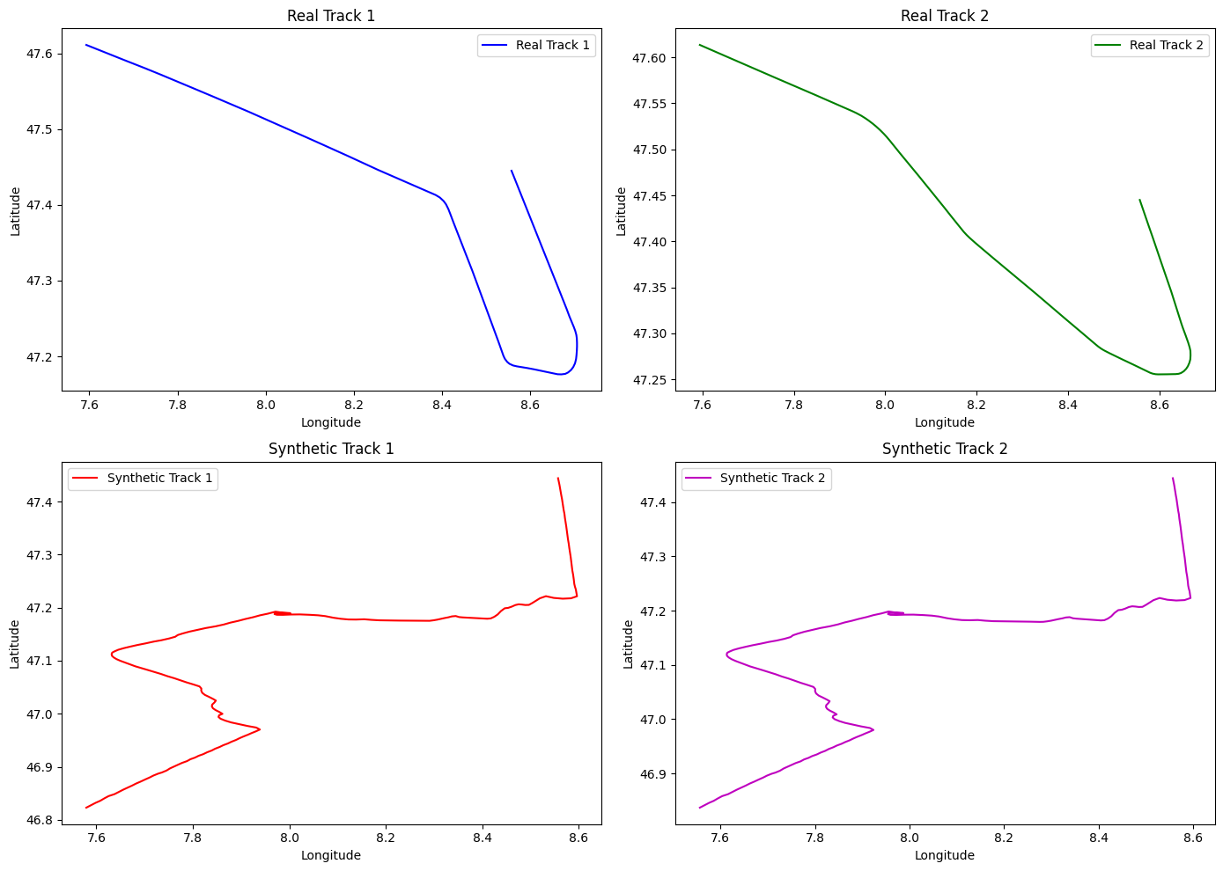
Wasserstein GANs

Slide 18
Summary
Embarked on generating synthetic flight tracks using GANs.
Preprocessed data with MinMaxScaler for GAN training.
Faced challenges with data value ranges and model diversity.
Modified GAN architecture to improve output value alignment.
Switched from StandardScaler to MinMaxScaler for better normalization.
Enhanced track diversity with data augmentation and parameter tuning.

Slide 19

Future Work
Implement Frechet Inception Distance (FID) and Inception Score (IS) for better model evaluation.
Explore progressive GANs and Wasserstein GANs for more realistic synthetic routes.
Integrate airspace regulations and weather conditions into the GAN training for increased authenticity.
Develop capabilities for real-time generation of synthetic flight tracks for dynamic applications.
Consider streaming GAN architectures to enable on-the-fly synthetic route generation.
Use advanced GAN techniques and quality metrics to enhance realism and diversity in generated tracks.

Slide 20

Q&A

